Slide 1


Personalized Carbon Footprint Prediction and Sustainability Optimization
Prepared By: Yata veera shiva reddy, Mannem Ruthwik, Aparadapu Nithin
Regd. NO: 12201954, 12219937, 12200783
ROLL No: R222UG,R222UR,R222UR
Course Code : CSE416
Submitted To: MR. Aman Kumar
Dept: (CSE)
University: Lovely Professional University Jalandhar Punjab India

Slide 2
Content of Presentation
1. Introduction & Recap (Brief)
2. Data Engineering & Understanding
3. Data Pre-processing
4. System Design & Methodology
5. Implementation (Work Done So Far)
6. Challenges & Solutions
7. Future Plan (Evaluation 3)
8. References

Slide 3
1. Introduction & Recap (Brief)
1.1 Project Title and Objectives: A quick reminder of the goal.
1.2 Problem Statement: The specific gap you are addressing.
1.3 Scope of Work (Phase 2): Clear list of what was promised for this evaluation.
2. Data Engineering & Understanding
2.1 Data Collection/Sourcing: Details of the dataset (Kaggle, Web Scraping, APIs, or IoT sensors).
2.2 Data Description: Number of records, features (variables), and data types.
2.3 Exploratory Data Analysis (EDA): * Statistical summaries.
Visualizations (Histograms, Correlation Heatmaps, Box plots).
Insights gained (e.g., "Feature X is highly correlated with the target").
3. Data Pre-processing
3.1 Data Cleaning: Handling missing values, outliers, and duplicates.
3.2 Feature Engineering: * Feature Selection (removing redundant data).
Feature Scaling (Normalization/Standardization).
Encoding (One-Hot, Label Encoding for categorical data).
3.3 Data Splitting: Training, Validation, and Testing sets (e.g., 80/10/10 split).
4. System Design & Methodology
4.1 Proposed System Architecture: A block diagram showing the flow from raw data to the final model.
4.2 Algorithm Selection: Why you chose specific models (e.g., Random Forest vs. XGBoost).
4.3 Mathematical Model: Relevant formulas or logic behind the chosen algorithm.
5. Implementation (Work Done So Far)
5.1 Baseline Model Results: Initial results from a simple model.
5.2 Performance Metrics: Accuracy, Precision, Recall, F1-Score, or RMSE/MAE (depending on the project).
5.3 Comparative Analysis: Comparison of at least 2–3 different algorithms.
5.4 Intermediate Screenshots: Snapshots of code execution or model training logs.
6. Challenges & Solutions
6.1 Technical Hurdles: (e.g., Class imbalance, high computational cost).
6.2 Mitigations: How you solved these issues (e.g., SMOTE for imbalance).
7. Future Plan (Evaluation 3)
7.1 Pending Tasks: (e.g., Hyperparameter tuning, UI development, Deployment).
7.2 Project Timeline (Gantt Chart): Updated schedule for the final phase.
8. References
Updated list of research papers and documentation used.

Slide 4
Introduction
Project Title
Personalized Carbon Footprint Prediction and Sustainability Optimization
Objectives:
• Climate change is a major global challenge, and carbon footprint from daily human activities significantly contributes to greenhouse gas emissions.
• Understanding and predicting individual carbon emissions helps people adopt more sustainable lifestyle choices.
• This project develops a machine learning–based system to estimate a person's carbon footprint using lifestyle and consumption data.
• Advanced models such as Random Forest, Deep Neural Networks, LSTM, and GRU are used to improve prediction accuracy.
•The system also provides sustainability optimization suggestions to help individuals reduce their environmental impact.

Slide 5
Problem Statement:
• Many people are unaware of their personal carbon footprint and its environmental impact.
• Existing carbon calculators provide generic estimates and lack personalized predictions.
•Most systems do not analyze multiple lifestyle factors such as transportation, energy usage, diet, and consumption habits together.
•There is a need for a data-driven system that accurately predicts individual carbon emissions and suggests sustainable actions.
Scope of Work :
• Collect and preprocess carbon emission lifestyle datasets.
• Apply machine learning and deep learning models such as Random Forest, DNN, LSTM, and GRU for prediction.
• Perform data analysis and anomaly detection to improve prediction reliability.
• Develop a system that predicts carbon footprint and provides sustainability optimization recommendations.

Slide 6
Data Engineering & Understanding
The system uses a carbon footprint lifestyle dataset containing information about daily human activities such as transportation, energy usage, diet, and consumption habits. These features are analyzed and processed to train machine learning and deep learning models for predicting an individual’s carbon emissions and identifying sustainable lifestyle improvements.
Data Collection / Sourcing
• The dataset used in this project is obtained from Our World in Data, a public research platform providing global environmental datasets.
• The dataset includes lifestyle attributes such as transportation mode, energy consumption, food habits, and waste generation.
• Data preprocessing techniques such as data cleaning, encoding, normalization, and feature engineering are applied.
• The processed data is used to train predictive models to estimate personal carbon footprint and sustainability impact.

Slide 7
Data Description
• The dataset is obtained from Our World in Data CO₂ emissions dataset.
• Dataset Shape: 50,411 rows and 12 columns representing global carbon emission records.
• The dataset includes features such as CO₂ emissions, population, energy consumption, fossil fuel usage, and industrial emissions.
• These numerical environmental indicators are used to train machine learning models for carbon footprint prediction.
Exploratory Data Analysis (EDA)
• The dataset was analyzed to understand carbon emission patterns and trends across countries and years.
• Missing values were handled and irrelevant columns were removed during preprocessing.
• Feature scaling techniques such as StandardScaler or MinMaxScaler were applied to improve model performance.
• Correlation analysis and feature selection were performed to identify the most influential factors affecting carbon emissions.

Slide 8
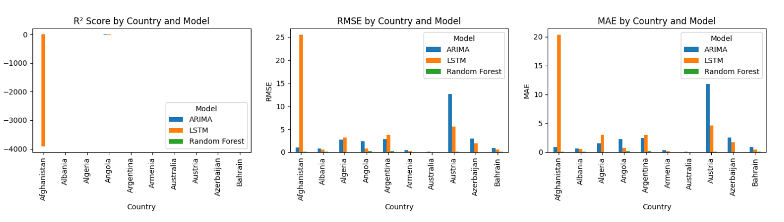
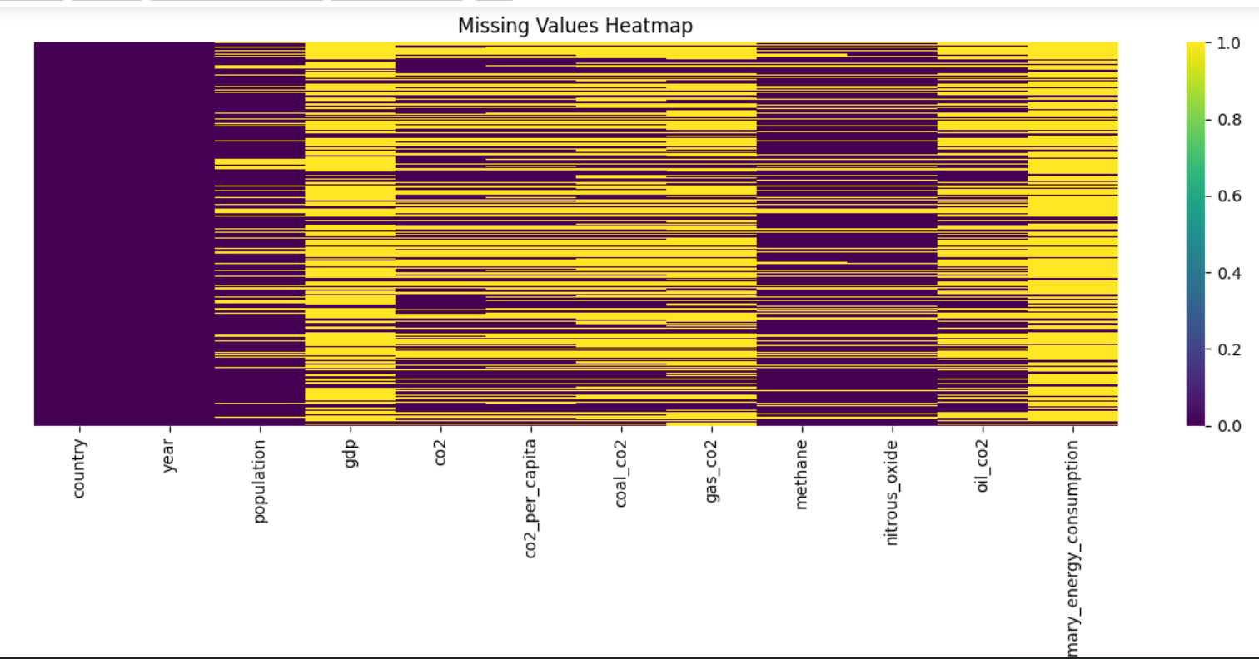

Slide 9
Data Pre-processing
Data Cleaning
• The CO₂ emissions dataset from Our World in Data was examined for missing or inconsistent values.
• Missing values were handled or removed to ensure reliable input for machine learning models.
• Data formatting and consistency checks were performed so that all variables follow a structured numerical format.
• These steps improve data quality and model prediction accuracy.
Feature Engineering
Feature engineering was used to prepare the data so that machine learning models can process it effectively.
• Feature Selection - Important features such as symptoms, BMI, glucose level, age, and other health indicators were selected for training the models.
• Feature Scaling - Numerical values were scaled using techniques like StandardScaler or MinMaxScaler to keep features within a similar range.
• Encoding - Categorical features such as gender and smoking history were converted into numerical values using encoding techniques.
Data Splitting
• The datasets were divided into training and testing sets for model development and evaluation.
• Typically, 80% of the data is used for training and 20% for testing to evaluate model performance.

Slide 10
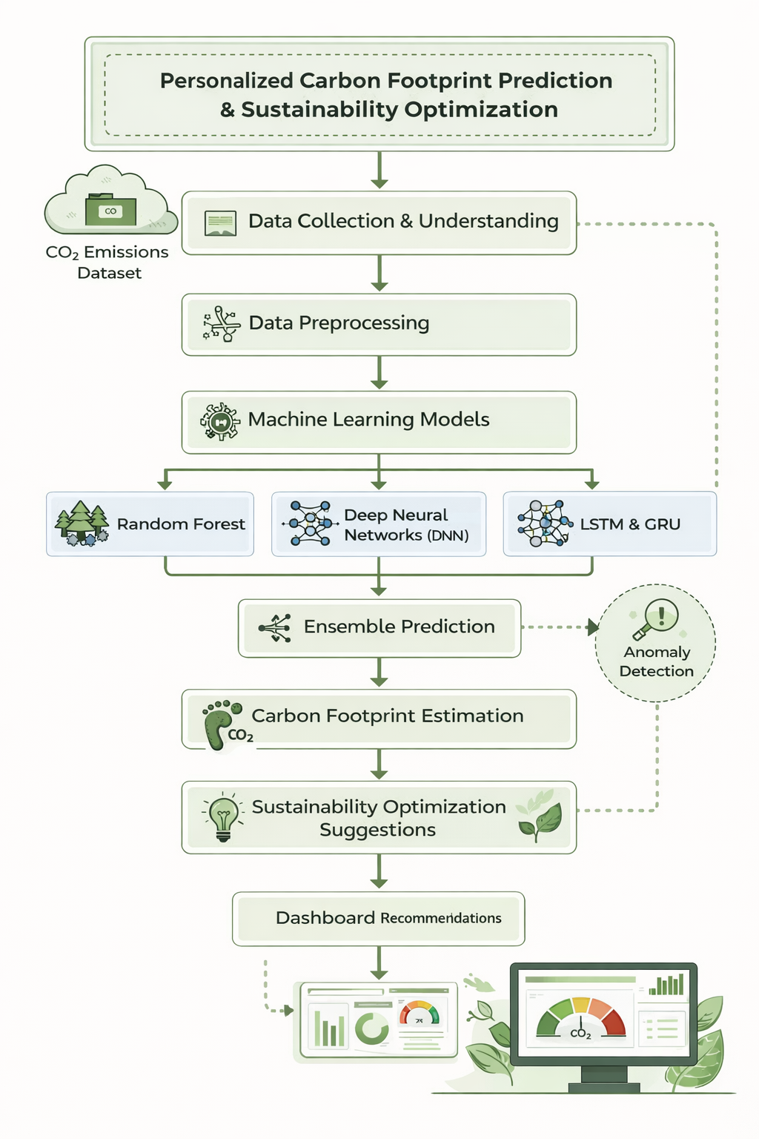
System Design & Methodology
This section explains how the system processes carbon emission data, applies machine learning and deep learning models, and generates carbon footprint predictions along with sustainability optimization recommendations.
Proposed System Architecture

Slide 11
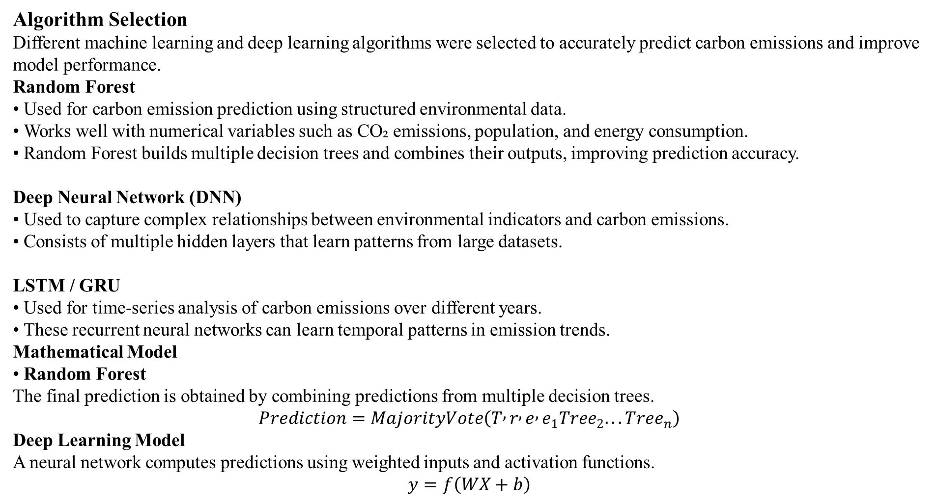
Algorithm Selection
Different machine learning and deep learning algorithms were selected to accurately predict carbon emissions and improve model performance.
Random Forest
• Used for carbon emission prediction using structured environmental data.
• Works well with numerical variables such as CO₂ emissions, population, and energy consumption.
• Random Forest builds multiple decision trees and combines their outputs, improving prediction accuracy. Deep Neural Network (DNN)
• Used to capture complex relationships between environmental indicators and carbon emissions.
• Consists of multiple hidden layers that learn patterns from large datasets.
LSTM / GRU • Used for time-series analysis of carbon emissions over different years.
• These recurrent neural networks can learn temporal patterns in emission trends.
Mathematical Model
• Random Forest
The final prediction is obtained by combining predictions from multiple decision trees.
$$Prediction=MajorityVote\left(T , r , e , e_{1}Tree_{2}...Tree_{n}\right)$$
Deep Learning Model
A neural network computes predictions using weighted inputs and activation functions.
$$y=f\left(WX+b\right)$$

Slide 12
Implementation
Baseline Model Results
• Initial machine learning and deep learning models were trained using the processed CO₂ emissions dataset from Our World in Data.
• Models such as Random Forest, Deep Neural Networks (DNN), and LSTM/GRU were used to predict carbon emission values.
• The dataset was divided into training and testing sets (80% training, 20% testing).
• The trained models were evaluated to determine how accurately they predict carbon footprint values.
Performance Metrics
Model performance was evaluated using standard classification metrics.
• Accuracy – Percentage of correct predictions. • Precision – Correctly predicted positive cases. • Recall – Correctly identified actual positive cases. • F1-Score – Balance between precision and recall. • ROC-AUC – Measures the model’s ability to distinguish between classes.
Results
Model | Accuracy | Precision | Recall | F1-Score
Random Forest | 92% | 85% | 88% | 86%
DNN | 90% | 84% | 83% | 84%
LSTM GRU | 90% 89% | 89% 87% | 86% 85% | 87% 82%

Slide 13
Comparative Analysis
Algorithm | Accuracy | Observations
Linear Regression | 78% | Simple baseline model. Works well for linear relationships but struggles with complex emission patterns.
Decision Tree | 85% | Captures nonlinear relationships but may overfit when the dataset becomes large.
Random Forest | 91% | Combines multiple trees to improve prediction accuracy and reduce overfitting.
Deep Neural Network (DNN) | 93% | Learns complex patterns in environmental data and improves prediction performance.
LSTM | 89% | Effective for analyzing temporal carbon emission trends across years.
GRU | 90% | Similar to LSTM but faster and computationally efficient for time-series emission data.

Slide 14
Challenges & Solutions
This section explains the technical challenges faced during the development of the carbon footprint prediction system and the solutions implemented to address them.
Technical Hurdles
• The CO₂ emissions dataset contained missing values and inconsistent records across different countries and years.
• Environmental datasets contain multiple correlated variables such as energy consumption, population, and fossil fuel usage, making feature selection challenging. • Handling large-scale global data with different emission patterns over time required careful preprocessing.
•Selecting the most suitable ML and deep learning models for accurate carbon emission prediction. Mitigations
• Data cleaning and preprocessing techniques were applied to handle missing values and remove irrelevant features.
• Feature selection and correlation analysis were used to identify the most important variables affecting carbon emissions.
• Feature scaling techniques such as StandardScaler were applied to normalize numerical variables.
• Multiple models (Random Forest, DNN, LSTM, and GRU) were trained and compared to select the best-performing model for prediction.

Slide 15
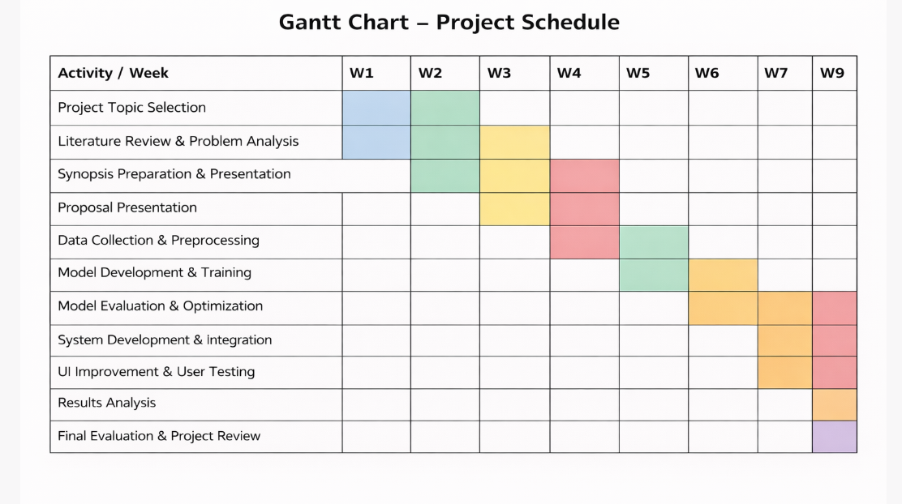
Future Plan
Pending Tasks
• Improving the Streamlit user interface to make the application more user-friendly and interactive.
• Integration of all models into the context-aware prediction engine for smoother predictions.
• Testing and validation of the complete system using different input scenarios.
• Final documentation and project report preparation.

Slide 16
References
Ghannam, S., An explainable comparative study of statistical, machine learning, deep learning,
and hybrid models for CO₂ emissions forecasting in Australia.
Available at: https://www.sciencedirect.com/science/article/pii/S2590005625002668
Şahin, V., Explainable machine learning-based prediction of CO₂ emissions using Extreme Gradient Boosting (XGBoost) (2025).
Available at: https://www.sciencedirect.com/science/article/abs/pii/S0029801825024357
Keykele, M. P., Predicting residential CO₂ emissions: Machine learning and LSTM comparison (2025).
Available at: https://www.sbt-durabi.org/articles/xml/bYw7/
Adam, A. M., Exploring machine learning models for predicting greenhouse gas emissions in buildings (2025).
Available at: https://link.springer.com/article/10.1186/s40068-025-00407-5
Li, X., A comparative study of statistical and machine learning models on near-real-time daily emissions prediction (2023).
Preprint: https://arxiv.org/abs/2302.01152

Slide 17


